Slide 1
The Minitube Group
Dr. Monika Esch

Slide 2


In 1970, Foundation of Minitüb

Slide 3

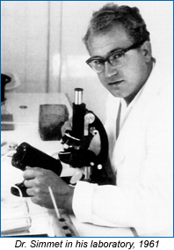
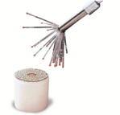
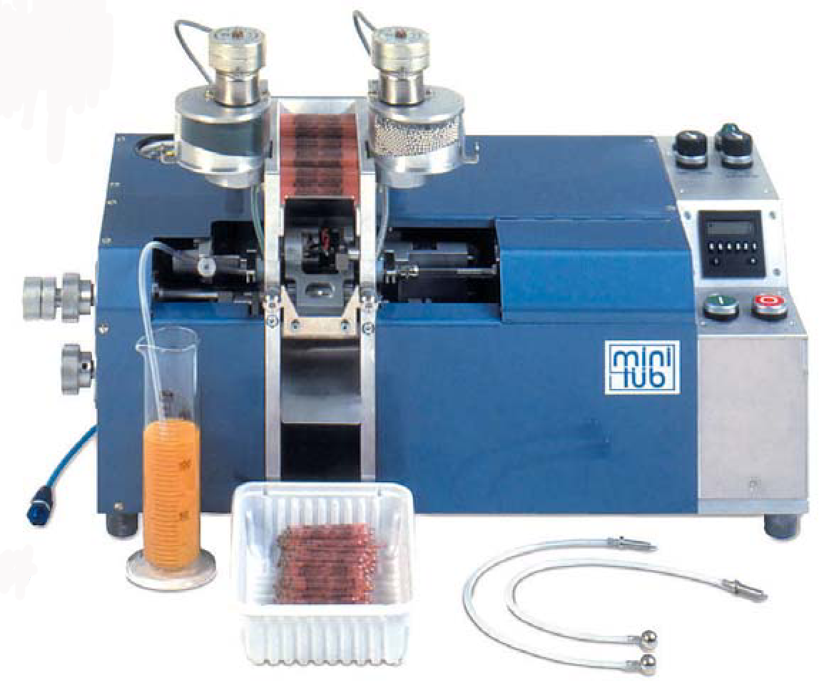

Slide 4
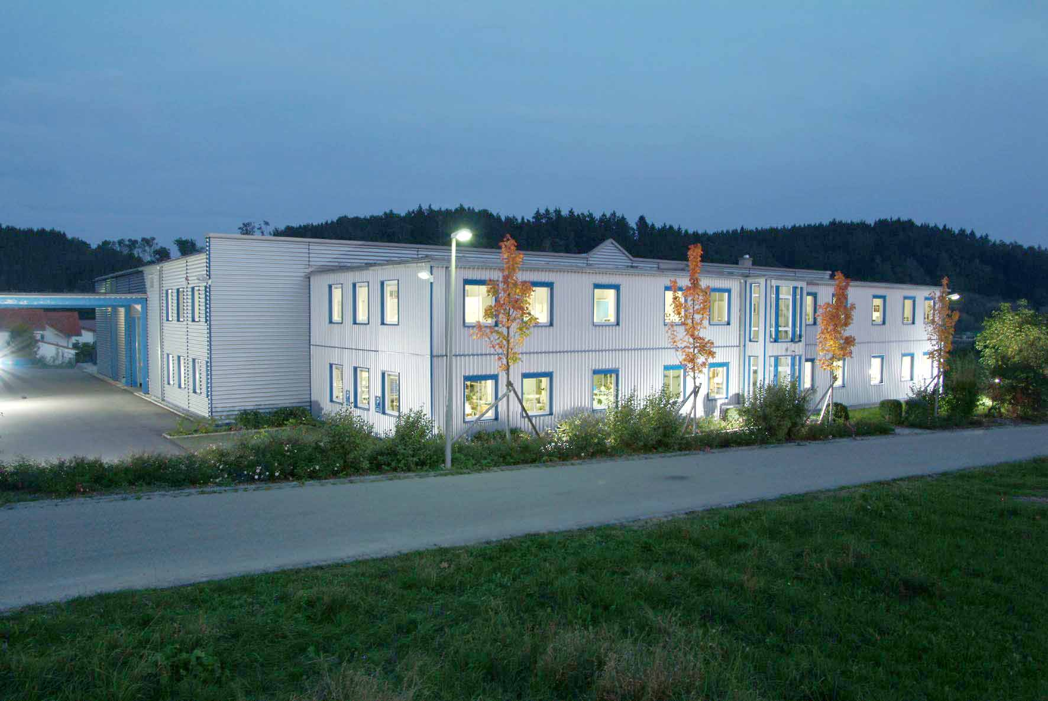
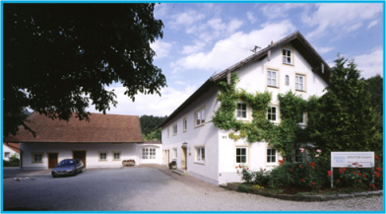
Headquarters Germany
Minitüb in Tiefenbach

Slide 5

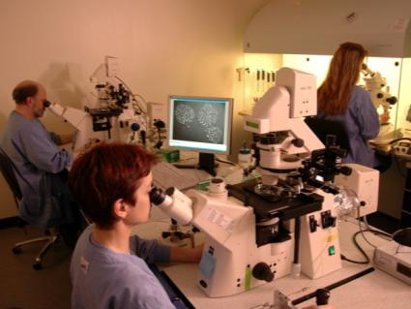
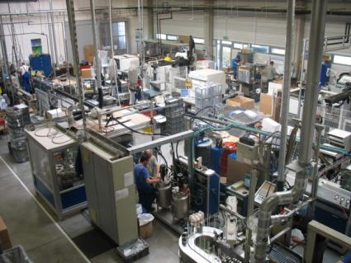
Our activities…
Research & Develpoment
Production
Sales
Notes:
5

Slide 6
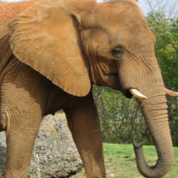
Our customers…
Breeders
Veterinarians
Universities/Research Institutes
A.I. centers
IVF-clinics
Farmers
Notes:
InVitroFertilization
6

Slide 7

Minitüb worldwide
Companies and training centers
Sales partner
Notes:
7

Slide 8
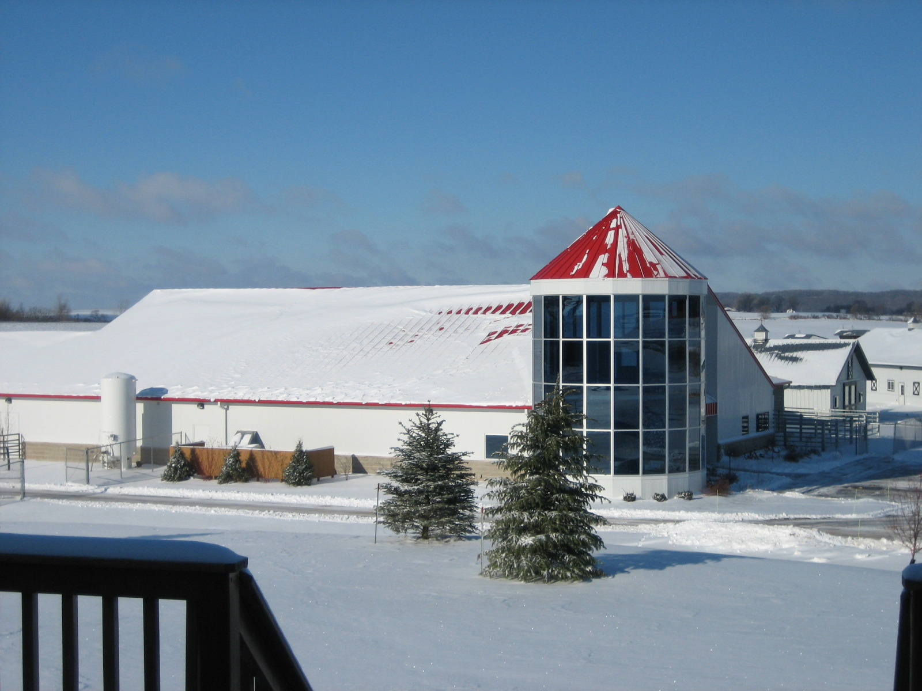
International Center for Biotechnology 2004

Slide 9
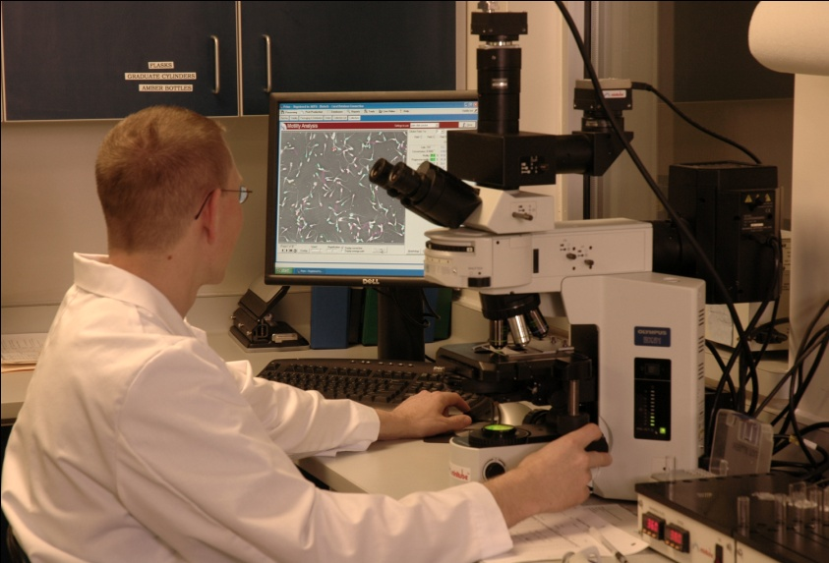
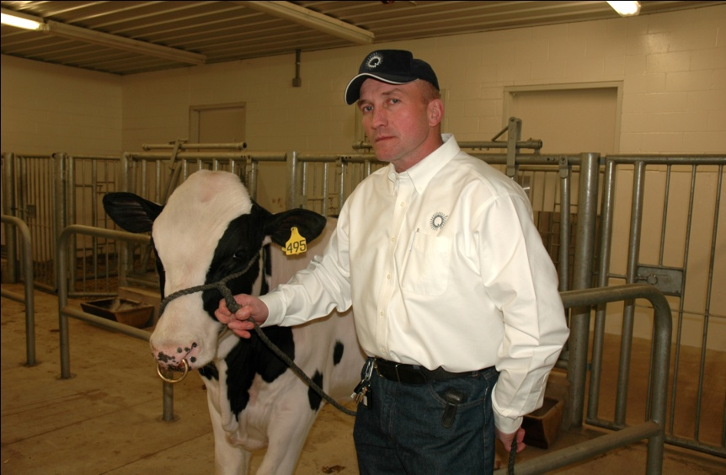
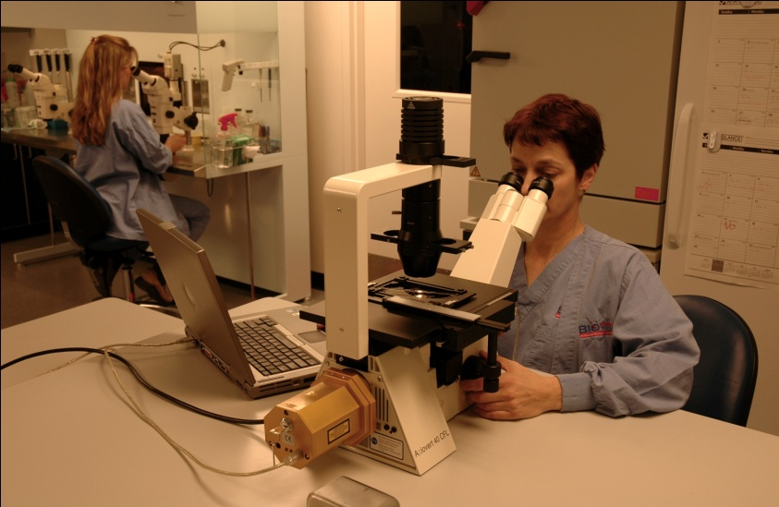
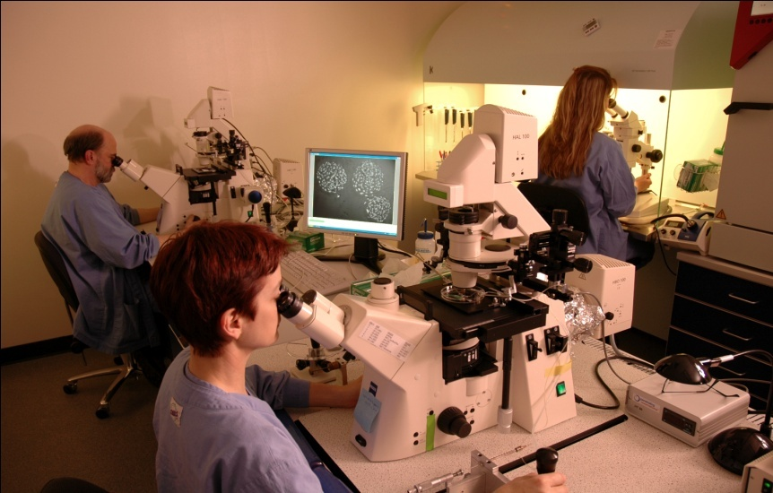
Minitube ICB Laboratories

Slide 10





Research Cooperations
University for Veterinary Medicine Hannover, Centre for Reproduction
University of Munich, Institute for Molecular Animal Production
Federal University of Rio Grande do Sul
University of Vienna,
Institute for Reproduction
University of Murcia,
Department of
Reproduction

Slide 11
Canine Artificial Insemination

Slide 12
Canine Artificial Insemination
The artificial insemination of dogs is not a new concept. The first reported insemination of a bitch is dated back to 1780.
Reduces the risk of infection which can occur with natural mating. Also the risk of infections such as Canine Flu during transport is eliminated.
Notes:
Deckrüden vor Infektionen.
Die häufig geforderte bakteriologische Untersuchung der Hündin vor dem Deckakt gewährleistet keine Sicherheit vor gefährlichen Infektionserregern wie Brucellose, Herpesvirus, Mykoplasmen oder anaeroben Keimen. Bei der künstlichen Samenübertragung fällt dieses Risiko für den Rüden weg.

Slide 13
Canine Artificial Insemination
High success rate:
  use of semen evaluated for fertility
  improved by addition of extenders
  because of the accurate timing of insemination.
No need for stud or female dog transport and stressful displacements
Fertilization even when:
  the male or the female dog have physical disorders
  psychological or cognitive disorders (inexperience, low sexual drive, hierarchy, trauma, fear, etc.)
One ejaculate can be split into multiple semen doses for AI
Reduce number of males for breeding programs

Slide 14
Canine Artificial Insemination
Evaluate the semen for the following parameters:
  Volume
  Appearance (consistency/colour)
  pH value
  Semen concentration
  Total sperm cell count in the ejaculate
  Motility of sperm cells
  Number of morphologically abnormal sperm cells
Notes:
These parameters inform whether the semen is appropriate for artificial insemination or would be suitable for natural mating.

Slide 15
Daily Sperm Production vs. Daily Sperm Output
Overuse of male dog?
  Collect once a day, but not every day
  -> every other day for months is o.k.!!

Slide 16
Semen collection and semen preservation
If possible always try natural mating first
Results with good breeding management:
    Natural mating 95-100%*
    Fresh/chilled semen 70-90%
    Frozen semen 65-90%
        *depending on the breed
    AI is indicated:
    when male and female dogs are located in
    distant locations
    vaginal anomaly exists

Slide 17
Semen collection and semen preservation
    Indications for semen collection:
      Diagnostic purposes:
        Older males (> 12 years of age)
        Males that have not been used for breeding for several years
        Males that have a history of infertile breedings or small litter sizes
        Males with abnormal preputial discharge, hematuria, hemospermia or other evidence of prostatic disease

Slide 18
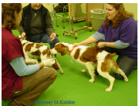
Semen collection and semen preservation
    Semen collection:
      Collect the semen using an oestrus bitch if possible (increases libido and ejaculation quality)
      Teaser bitch
      Bitch in anoestrus
      Pheromone cotton swab (from a female in heat, stored in fridge)
      Play
      Quiet room
      Effect of the owner

Slide 19
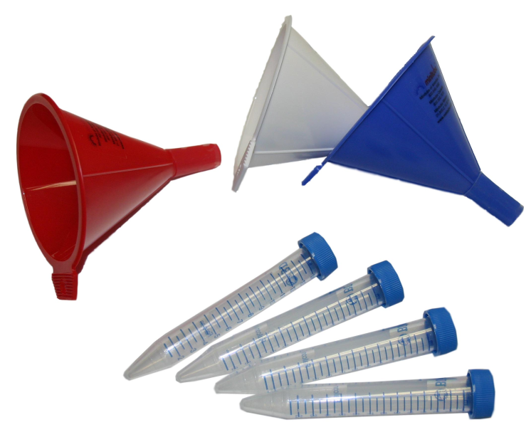
Semen collection
    Materials:
      Centrifuge tubes or specimen cups
        Always try to separate the 3 fractions:
        1st prostatic (passive) – normally transparent
        2nd spermatic – normally cloudy
        3rd prostatic (active) – transparent, high volume
      1st / 2nd fractions combined when separation not possible but
        Copious 1st fraction
        Urine contamination
      3rd fraction contamination

Slide 20
Semen collection
Minitüb funnel system
    Red funnel - first fraction of the ejaculate.
    Blue funnel - “Sperm Rich” second fraction.
    White funnel - third fraction (prostatic fluid).
        Better visualization
        Making separation easy
        Identify penis problems (vesicles, lesions, bleeding, inflammation) during full erection.
  Take sample to the laboratory
  Discard the other two parts of the ejaculate (if not required for any diagnostic tests).

Slide 21
Semen evaluation
Volume
  Depends on prostatic fraction
    3 to 30 ml or more
    If a low volume is collected:
      Make sure that you have taken the entirely of the 2nd fraction of ejaculate
  Colour
    Normal: opaque, cloudy / milky
  pH
    Normal 6.5 to 7.0
  Density
    Very good 750 – 1.000 Mio sperm/ml
    Good 400 – 750 Mio sperm/ml
    Fair 250 – 400 Mio sperm/ml
    Poor < 250 Mio sperm/ml

Slide 22
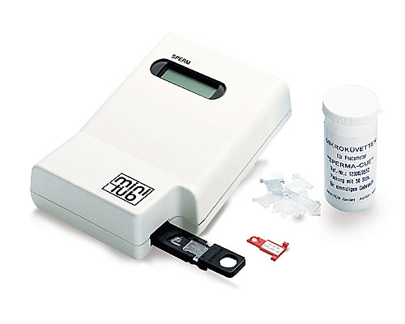
SpermaCue
Semen evaluation

Slide 23
Semen evaluation
Total spermatozoa in ejaculate
  Volume x sperm concentration/ml
  Average: 1,25 billion / ejaculate
  Range: 300 million – 2 billion
  Variable because:
    Age
    Breed
    Size of testes
  Minimum insemination dose:
    100 million normal motile spermatozoa per dose

Slide 24
Semen preservation objectives
Objectives:
  Conserve semen at:
    approx. 5 degrees C for a few days
    or at -196 degrees for … years
  Conservation Medium should:
    Maintain osmolarity and pH, prevent oxydative stress
    Provide energy substrates

Slide 25
Semen preservation
Spermicidal Substances:
  Many disposable syringes and insemination pipettes
  Disposable gloves
  Many lubricants
  Detergents and disinfectants
  Water and air
  Seminal gel

Slide 26
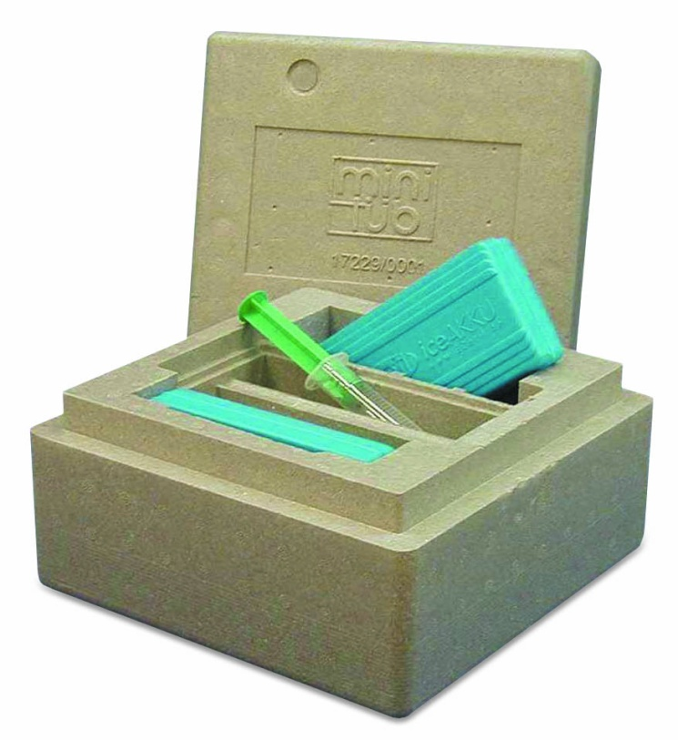
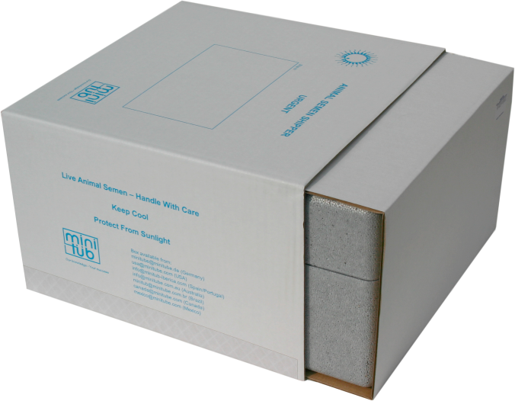
Semen chilling
Transport box:
  Before closing the box it is good to check a re-warmed drop of semen for vitality after chilling.

Slide 27
Semen chilling
Method of use
  Do a trial storage before shipping
  Important criteria:
    Bitch management
    Do not shock or harm sperm
    Correct cooling rates
    Correct temperature during storage
  Close and seal the shipping box, making sure that some extra extender is included in the package as well as the insemination instructions and eventually syringe and insemination pipettes if the semen is to be send to a breeder.

Slide 28
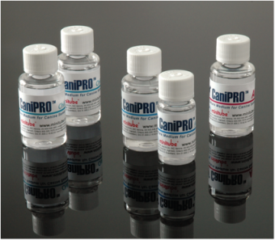
Semen chilling
Extenders
  Many extenders are nowadays available
    They allow preservation over 3 to 10 days

Slide 29
Semen freezing
    Indications
      Cryopreservation:
        Allows stud dog owners to preserve valuable genetic material for future breeding
        Allows for breeding when the male is dead or no longer fertile
        Allows for breeding to a male that is unavailable for breeding
        Allows for international exchange over long distances or when quarantine exists

Slide 30
Semen freezing
  Whelping rates:
  Results after AI with frozen-thawed semen are highly variable and depend on:
    Method used
    Site of deposition
    Number of inseminations and inseminated sperm
    Semen quality, handling ….

Slide 31
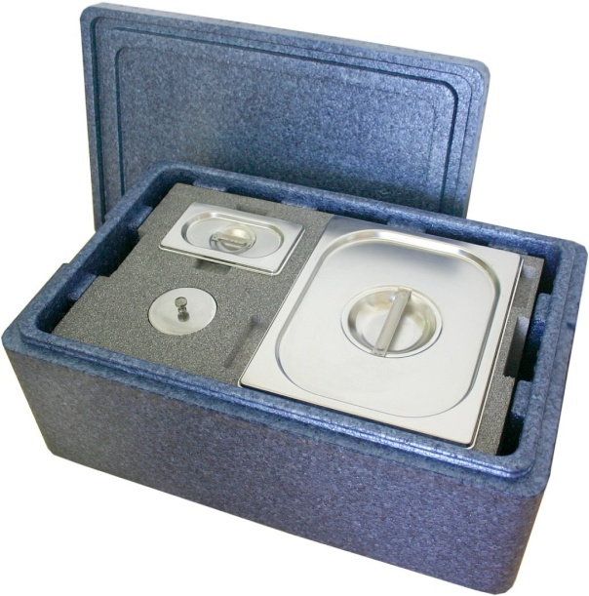
Freezing unit

Slide 32
Breeding management
  Mono-oestrus: one cycle per season???
  Seasonal → but:
    Mean inter-oestrous interval 7 months
      No real correlation with season
      Highly variable between breeds
      High variations in the same breed
      High variations in the same animal
    Keyword about canine cycle: VARIABILITY

Slide 33
Breeding management
  Canine oestrous cycle
  Relations between sexual behaviour and cycle:
  Pro-oestrous: average 9 days (2-27 days)
  Oestrous: average 9 days (3-21 days)

Slide 34
Breeding management
  Should begin 3-5 days after first bleedings:
    Vaginal smears
    Vaginoscopy
    Progesterone assays
      Best to inseminate with fresh semen or mate twice at 48 h interval from 5-7 ng/ml
      Best to inseminate with frozen semen or poor quality semen twice at 24 h interval from 9-10 ng/ml
      Poor breeding management is the main cause of infertility in the bitch

Slide 35
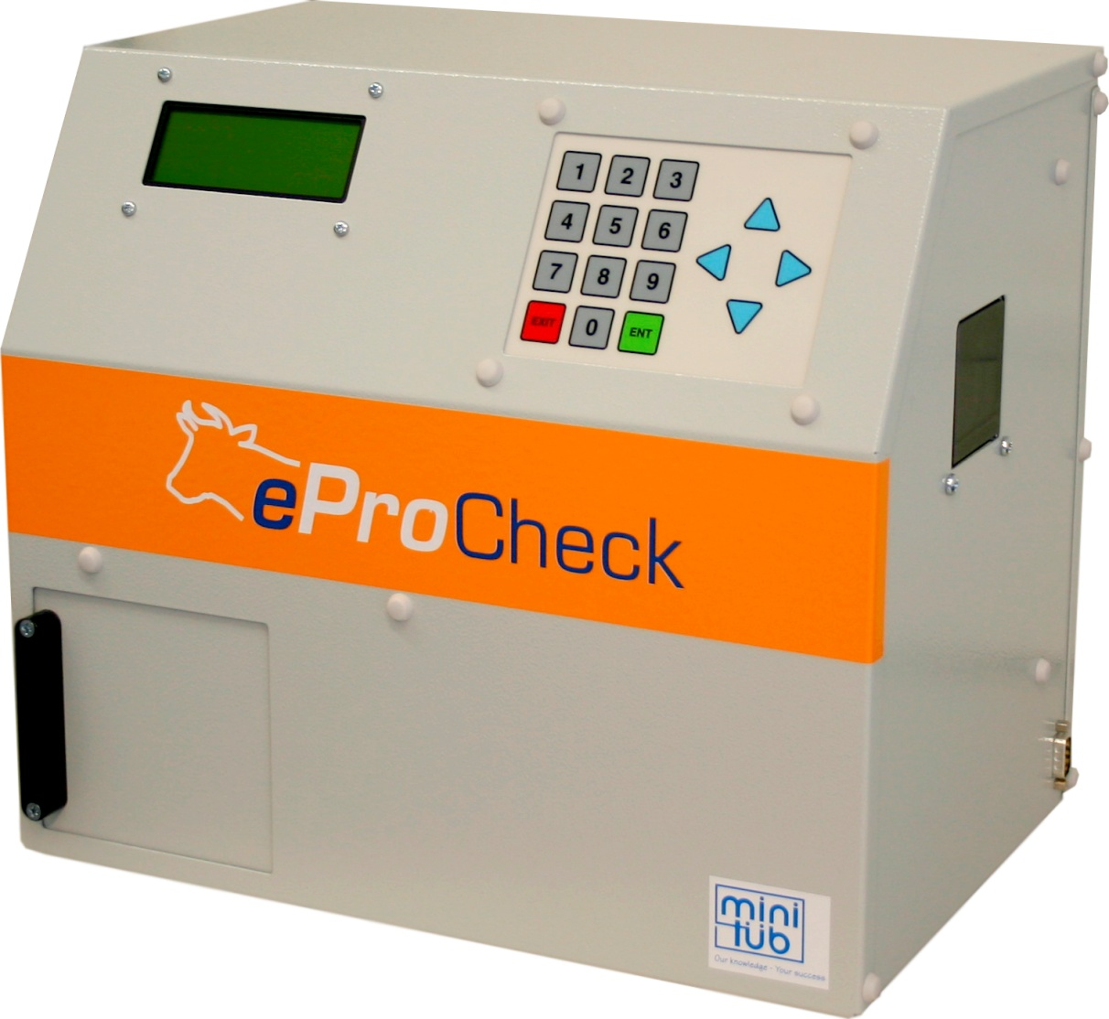
Progesterone measurement
eProCheck measures Progesterone automatically
Serum sample necessary

Slide 36
Breeding management
  Vaginal smears
    Easy and cheap
      Cotton swab into the vagina
      Scraping the mucosa
      Rolling the swab on the slide
      Diff-Quick and/or Harris-Schorr
    No possibility to predict ovulation or the time peak fertility
    The use of vaginal smears improve results of breeding management from 40% up to 60-65% of success rate

Slide 37
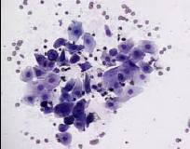
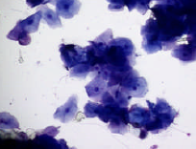
Breeding management
  Pro-Oestrous
    Red blood cells
    Mitosis
    Different types of cells
      Parabasal
      Intermediate
      Superficial (=late Pro-Oestrous)
  Oestrous
    Decrease in RBC
    Only superficial cells
      Picnotic
      Anuclear
      cornified
    No other cells!

Slide 38
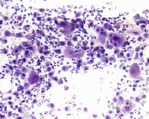
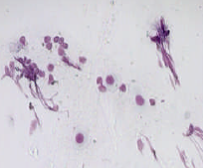
Breeding management
  Met-Oestrous
    More than 20% nucleated cells
    “Rush”
      Leukocytes ++++
      All types of cells
      Met-oestrum cells (=big cell – no breeding!)
      Foam cells
      Mucus
  An-Oestrous
    Very few cells
    Parabasal and small intermediate
    Mucus
    Isolated nuclei

Slide 39
Breeding management vaginal endoscopy
  Allows for an improvement of breeding management results from 60-65% to 80-90%
  However:
  experience is needed
  Still a large window for the period of insemination
  Progesterone essay is needed in conjunction with these 2 techniques to optimise results

Slide 40
Artificial Insemination
  Volumes:
  Depending on the semen quality at the time of insemination, perform either:
  • Vaginal insemination with a MAVIC catheter using the chilled semen and extra
  extender at room temperature to ideally reach the following total volumes:
  o 2-5 cc for bitches <10 kg
  o 5-10 cc for bitches between 11 and 19 kg
  o Up to 20 cc for bitches > 20 kg
  Note: These volumes simulate the volumes produced during natural mating. At time of insemination first inject the extended semen, then flush with the extra volume of extender mimicking the events happening during the tie.
  • TCI or surgical insemination using 1 – 3 cc of extended semen depending on the size of the bitch.

Slide 41
Artificial Insemination
  Vaginal:
    Pipette
    MAVIC
  Surgical:
    Laparotomy
      General anesthesia
      Incision 4-6 cm linea alba
      Locate the uterus
      Bring the uterus extra-abdominally

Slide 42
MAVIC
Three sizes: 400 mm length, 100 ml balloon
250 mm length, 50 ml balloon
150 mm length, 50 ml balloon

Slide 43
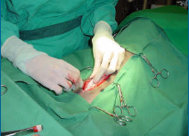
Artificial Insemination
  Laparotomy: surgical insemination:
    General anesthesia
    Incision 4-6 cm linea alba
    Locate uterus
    Bring uterus extra-abdominally

Slide 44
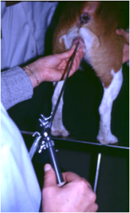
Artificial Insemination
  Endoscopic:
    With frozen / poor quality semen – intra-uterus
      Procedure:
      Insert endoscope in the dorsal commisure of the vulva
      Pass dorsal medial fold and search for the cervical tubercle
      Cervical os = ventrally located
      Pass plastic catheter through cervical opening

Slide 45
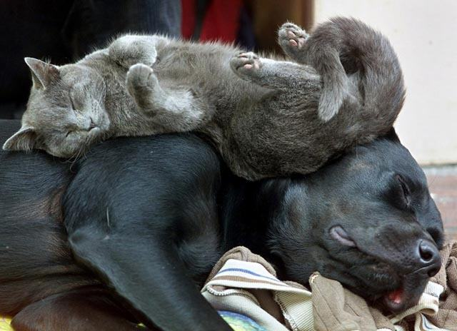
Thank you very much

